Slide 1

CPE 490 Embedded Systems Lecture 14
Some concept definitions (Wilmhurst Chapter 18.1)
Achieving multi-tasking with sequential programming (Wilmhurst Chapter 18.2)
RTOS Concepts
Much of this presentation comes from www.freertos.org tutorial
As well as “Using the FreeRTOS Real Time Kernal, A Practical Guide”, Richard Barry, 2010 version 1.3.2.

Slide 2
Motivation for Real Time Operating System (RTOS)
Basic problem: one microprocessor many things to do.
I can only do one thing at a time so how do I get many things done at once.
The things I must do have different levels of importance based upon
Importance to mission
Deadlines of when the job must be finished
Notes:
Think of a phone ringing I might have to answer it within 5 rings an definite deadline. But, mailing a letter might be of lower urgency because the postman does not come for 3 hours.

Slide 3
Definitions
Task – Is a single program process, strand, or section. It has a clear and distinct purpose and outcome. It is independent of other tasks, and it can’t call other tasks.
Multi-tasking – Many tasks performed ideally simultaneously.
Task Priorities – Task have priority, that is relative to the other tasks. Higher priority tasks run before lower priority tasks.
Deadline – when the task must be done, this can be based upon times or events.
Notes:
Deadline like you must answer the phone in so many rings (a time restriction). You must get the kids out the door before the bus comes (and event)

Slide 4
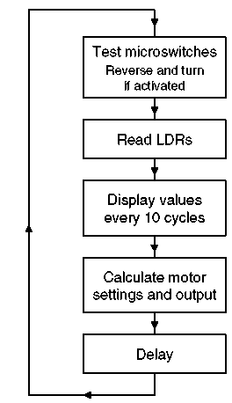
A Multitasking Example
Super loop or Kernel construction
LDRs are light dependent resistors to gather navigation data
Display is update every 10th time through the loop
Delay to give some control over program timing

Slide 5
Real Time
So what does it mean to operate in “Real Time” (in contrast to false time?)
A system operating in real time must be able to provide the correct results at the required time deadlines.

Slide 6
Priority and Deadline Example
Task | Priority | Deadline (ms)
Respond to microswitches | 1 | 20
Read LDRs | 2 | 50
Calculate and set motor speed | 2 | 50
Display | 3 | 500
Deadlines can be difficult and subjective to set.

Slide 7
Problems with Super Loop Approach
Loop execution time is not constant.
Tasks interfere with each other.
High priority tasks don’t get the attention they need.
Notes:
Loop execution time is not contant: Since each task will have conditional code (if then ) execution time must vary. Even though the overall loop execution can be kept constant with a delay it the delay is dynamic.
Tasks interfere with each other: As a result of uneven time execution one task can interfere with another. For example the 10th time through motor changes to sensors is going to come later than the loop before.
Priority does not matter: What would happen if the a limit switch gets activated just after reading the micro switches, it is a long time until this code runs again

Slide 8
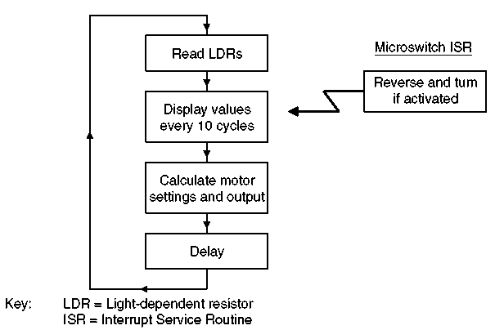
Using Interrupts for Prioritization – the Foreground/Background Structure
High priority event triggered tasks can be brought to the foreground by using an interrupt
The background events are usually time based interrupts and can use the repetition of the rate of the loop.
Notes:
We can see the deadline for reacting to the micro switch is and event driven.
While the updating of the display is a time based event.

Slide 9
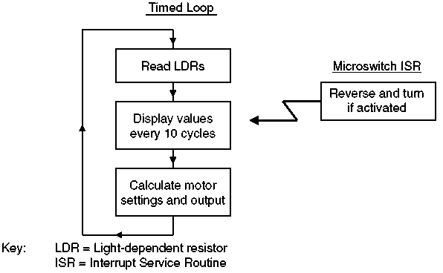
‘Clock Tick’ for Synchronization
Timer can be used to make a interrupt that can be used to fix loop rate of execution
Notes:
If the timer tasks would run in the interrupt (not a good idea). Nesting of interrupts would have to be enabled.

Slide 10
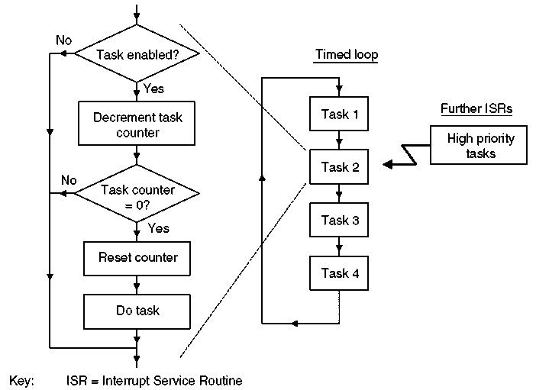
Refining Loop Based Timing Execution
Each task will have an enable flag
Each task can execute on a multiple of loop executions

Slide 11
Remaining Problems
Still only two priorities either your in the interrupt structure or in the timing loop
Timing loop tasks still must wait for other tasks to end before execution can occur.
The tasks must cooperate with each other, if a task would hog the processor there is limited mechanisms to ensure ‘fairness’.

Slide 12
The Limits of Sequential Programming when Multi-Tasking
The interrupt and time tick ‘operating system’ works when:
There are not too many tasks;
Task priorities can be accommodated in the structure;
Tasks are moderately well behaved, for example their requirement for CPU time is always reasonable, and interrupt-driven tasks don’t occur too often.
If these limits are too much time to consider a Real Time Operating System (RTOS)

Slide 13
Real Time Operating System
Operating System (OS): a layer of SW that provides low level services and management of tasks or applications. This management consists of: scheduling the tasks, managing the context of the tasks, provide communication and synchronization between tasks and sharing and allocating system resources (e.g. peripherals) between the tasks.
RTOS: an OS that allows one to specify constraints on the rate of process, that guarantees that these rate constraints will be met.

Slide 14
Why RTOS?
Abstracting away timing information: Each task will have a simple API interface to the kernel (the core component of the OS) which will take care of the timing issues.
Maintainability / Extensibility : abstracting the timing information means that tasks are not interrelated. This means that it is easier to change an application without effecting others and easier to add tasks.
Notes:
Point 1: Typically you configure the RTOS for the Time Tick period but all the details are handled by the RTOS.
Point 2: In a super loop the order of task execution is set by the programmer by the order in the kernel. In the RTOS we don’t worry about that we only worry about setting priority levels.

Slide 15
Why RTOS?
Modularity: Since the tasks are not dependent on each other they can be modular only doing one well defined purpose. This leads to:
Easier team development
Easier testing
Code reuse
Notes:
Limited knowledge is needed about other tasks to develop a specific task.

Slide 16
Why RTOS?
Improved Efficiency – With an RTOS you never have to wait around for an event using polling techniques e.g. while (check_busy) {}. You can use either:
Interrupts on the events or
Periodic calls to check on conditions (polling but in a controlled way that is efficient)
Counter to the efficiency is that RTOS take up resources when they switch from one task to another.
Notes:
Point 1: even if you the task must wait for an external event to happen, if it has not happened it can release the CPU to the kernel when this occurs.
Point 2: In general there is a trade off between the time specificity and efficiency of the code.

Slide 17
Why RTOS?
Idle time: an idle task is created by default in a RTOS. This task can measure the amount of idle time while keeping all other tasks serviced. The amount of idle time is a measure of the utilization of the processor.
Flexible interrupt handling: ISRs can be very short because most of the code is deferred to handler tasks.
Notes:
Flags set in interrupts can be used to push a task to the ready state.

Slide 18
Why RTOS?
Mixed processing requirement: periodic, continuous, an event-driven processing within an application can all be taken care of . In addition the RTOS will let you set priorities for both soft and hard time requirements
Easier control and sharing of peripherals amongst tasks.

Slide 19
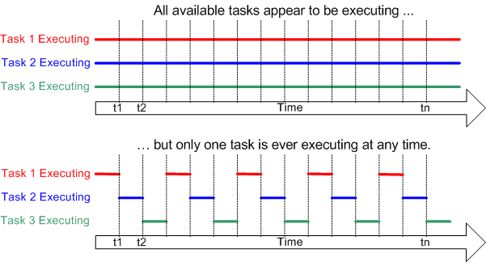
Multitasking
Notes:
Multiple tasks running at the same time through time multiplexing.

Slide 20
Why Multitasking?
Lets you divide up the program into smaller, easier to read, easier to maintain and more manageable tasks.
A task can be verified individually then used in multiple programs.
Through system architecture the problem can be divided into tasks that multiple people can work on in parallel.
Timing and sequencing of code can be abstracted from the task.

Slide 21
RTOS Tasks
Each Task is a small program in its own right
Implemented as a function
It has an entry point
Normally runs forever in an infinite loop
Tasks should never execute the return statement and should never reach the ending bracket of the function
That is not to say that you can not end and delete a task

Slide 22
Task State
Running
Ready
Blocked
At any instance only one Task can be running
All other tasks are either ready to run or blocked

Slide 23
Scheduling Terms
Scheduler: Part of the kernel that decides which task should execute, when, and for how long. The scheduler can start and stop a task numerous times before the task finishes.
Scheduler Policy: The algorithm in the scheduler that is used to “fairly” divide processor time between tasks.
Notes:
Note scheduler in a corporative OS can not stop a task only start it.

Slide 24
Scheduling Algorithms - Preemptive
Non-preemptive Scheduler – Scheduler will start the highest priority task and then not switch tasks until current task completes or blocks itself. Sometimes called Co-operative scheduling
Preemptive Scheduler – Will only let a task execute for a predefined time quantum or tick and then re-evaluate for the highest priority ready task. It will preempt the current task if a higher priority task is ready.

Slide 25
Scheduling Algorithms – Priority
Fixed Priority – The kernel can not change the priority of a task
Dynamic Priority – The kernel can change the priority on the fly. For example aging of waiting tasks could cause them to increase in priority.

Slide 26
Scheduling Algorithms – Round Robin
Round Robin: If a scheduler is preemptive and if a number of tasks of the same priority are ready then each time tick or time Quantum a new ready task will be run
Priority Scheduling: If a scheduler is non-preemptive then first come first serve each tasks runs to finish

Slide 27
Task Time Requirement
Period of a process: a repeating time interval during which that process has to execute at least once.
Execution deadline: the time before which a process must run to completion.
Notes:
Period might be screen refresh rate that must be kept.
In the case of execution deadline it does not talk about how often something should be checked it defines how much time a process has to complete once it is started. A task can have both a period and an execution deadline.

Slide 28
How to Determine Priority?
One way is to assign the highest priority to the most frequent (i.e. smallest period) task, called rate monotonic scheduling
Another way is to assign the higher priority to the task that has the tightest (least time) deadline, called deadline monotonic scheduling
Consider: both rate and deadline in making priorities

Slide 29
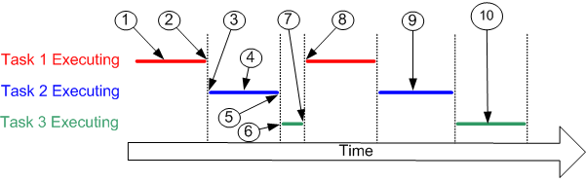
Example of Tasks Being Scheduled
A task can suspend itself (7) by delaying or sleeping for a fixed period of time, or by waiting or blocking until a resource becomes available or some eternal event occurs.
Notes:
At (1) task 1 is executing.
At (2) the kernel suspends task 1 ...
... and at (3) resumes task 2.
While task 2 is executing (4), it locks a processor peripheral for it's own exclusive access.
At (5) the kernel suspends task 2 ...
... and at (6) resumes task 3.
Task 3 tries to access the same processor peripheral, finding it locked task 3 cannot continue so suspends itself at (7).
At (8) the kernel resumes task 1.
Etc.
The next time task 2 is executing (9) it finishes with the processor peripheral and unlocks it.
The next time task 3 is executing (10) it finds it can now access the processor peripheral and this time executes until suspended by the kernel.

Slide 30
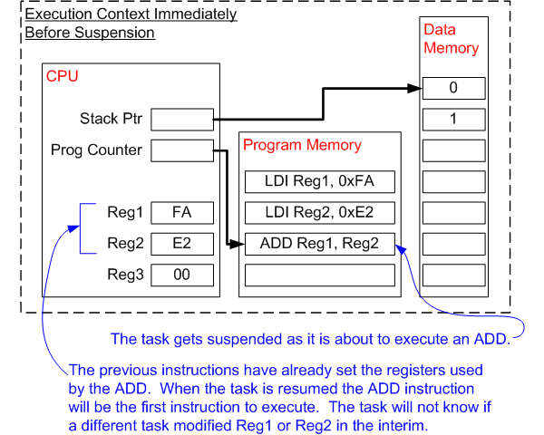
Context Switching
Notes:
The operating system kernel is responsible for ensuring this is the case - and does so by saving the context of a task as it is suspended. When the task is resumed its saved context is restored by the operating system kernel prior to its execution.

Slide 31
Terms
Context of a Task: All the information needed to be restored so that a task can be restarted this includes:
Program Counter
Status Register
Working Registers
Stack Pointers values
Context Switching: The action of saving the context of one task and restoring the context of another task.
Latency: The time it takes to do context switching

Slide 32
RTOS Scheduling
The difference between an OS and RTOS is in the scheduling policy
In a RTOS, events must be responded to within a deadline that is set by the context of the program.
For example assume that you must respond to a key press within 100ms and your must sample, filter, and run a control loop every 2 ms with sampling period of 2 ms ±.5 ms having to be maintained

Slide 33
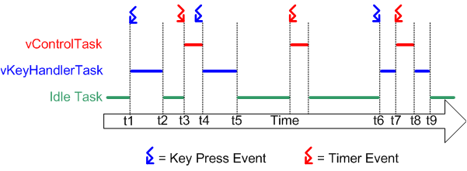
RTOS Preemptive Scheduling Example
Notes:
Referring to the diagram above:
At the start neither of our two tasks are able to run - vControlTask is waiting for the correct time to start a new control cycle and vKeyHandlerTask is waiting for a key to be pressed. Processor time is given to the RTOS idle task.
At time t1, a key press occurs. vKeyHandlerTask is now able to execute - it has a higher priority than the RTOS idle task so is given processor time.
At time t2 vKeyHandlerTask has completed processing the key and updating the LCD. It cannot continue until another key has been pressed so suspends itself and the RTOS idle task is again resumed.
At time t3 a timer event indicates that it is time to perform the next control cycle. vControlTask can now execute and as the highest priority task is scheduled processor time immediately.
Between time t3 and t4, while vControlTask is still executing, a key press occurs. vKeyHandlerTask is now able to execute, but as it has a lower priority than vControlTask it is not scheduled any processor time.
At t4 vControlTask completes processing the control cycle and cannot restart until the next timer event - it suspends itself. vKeyHandlerTask is now the task with the highest priority that is able to run so is scheduled processor time in order to process the previous key press.
At t5 the key press has been processed, and vKeyHandlerTask suspends itself to wait for the next key event. Again neither of our tasks are able to execute and the RTOS idle task is scheduled processor time.
Between t5 and t6 a timer event is processed, but no further key presses occur.
The next key press occurs at time t6, but before vKeyHandlerTask has completed processing the key a timer event occurs. Now both tasks are able to execute. As vControlTask has the higher priority vKeyHandlerTask is suspended before it has completed processing the key, and vControlTask is scheduled processor time.
At t8 vControlTask completes processing the control cycle and suspends itself to wait for the next. vKeyHandlerTask is again the highest priority task that is able to run so is scheduled processor time so the key press processing can be completed.

Slide 34
RTOS Tick
The RTOS kernel needs to know time in order to allow tasks to sleep for a certain duration.
A timer is setup with an ISR to keep track of time.
The ISR will increment a counter, the tick variable, so time between events can be tracked.
A task executing can be interrupted by the timer and then preempted if the a higher priority task is to wake up the next tick.

Slide 35
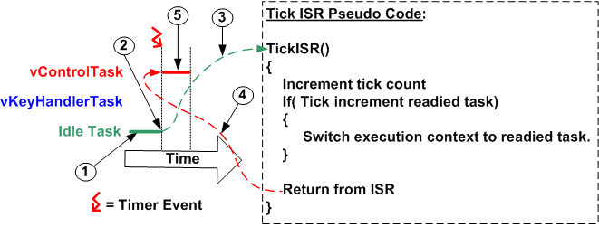
RTOS Tick Preemptive Example
Notes:
At (1) the RTOS idle task is executing.
At (2) the RTOS tick occurs, and control transfers to the tick ISR (3).
The RTOS tick ISR makes vControlTask ready to run, and as vControlTask has a higher priority than the RTOS idle task, switches the context to that of vControlTask.
As the execution context is now that of vControlTask, exiting the ISR (4) returns control to vControlTask, which starts executing (5)

Slide 36
FreeRTOS
This is free open source code that can be found at freertos.org
It is made for small to midsize processors of:
32 to 512 kbytes of ROM
16 to 256 kbytes or RAM
FreeRTOS is a real time kernel or scheduler on top of which embedded applications can be built to meet hard real time requirements
Notes:
dsPIC33 has 256 K ROM, and 30 k of RAM.

Slide 37
Commercial Application
FreeRTOS can be commercially used in products under a modified GNU General Purpose License (GPL) with the provision that any modification to FreeRTOS is open source code, and you state to every customer that you are using FreeRTOS. The code is royalty free and has no warranty.
The rest of the code as long as it uses just the provided API is still closed source.
Other versions are for sale if you don’t want any open source, state that your using it, or want support.

